Slide 1
Securing Blockchain Tokens (coins)
@gummatt - 2017

Slide 2
Problems
Exchanges get hacked
True blockchains are immutable and don’t do charge backs.
Computers get hacked
Houses burn down - scary stuff.
@gummatt - 2017

Slide 3
Solutions
Be paranoid.
Never leave tokens on an exchange.
Never let keys hit an internet connected computer.
Never leave more than $100 in a mobile wallet.
Beat the $5 wrench.
Have a plan for your house burning down.

Slide 4
Tools.
Paper wallets
Brain wallets
Hardare wallets
Fireproof seed solutions.

Slide 5
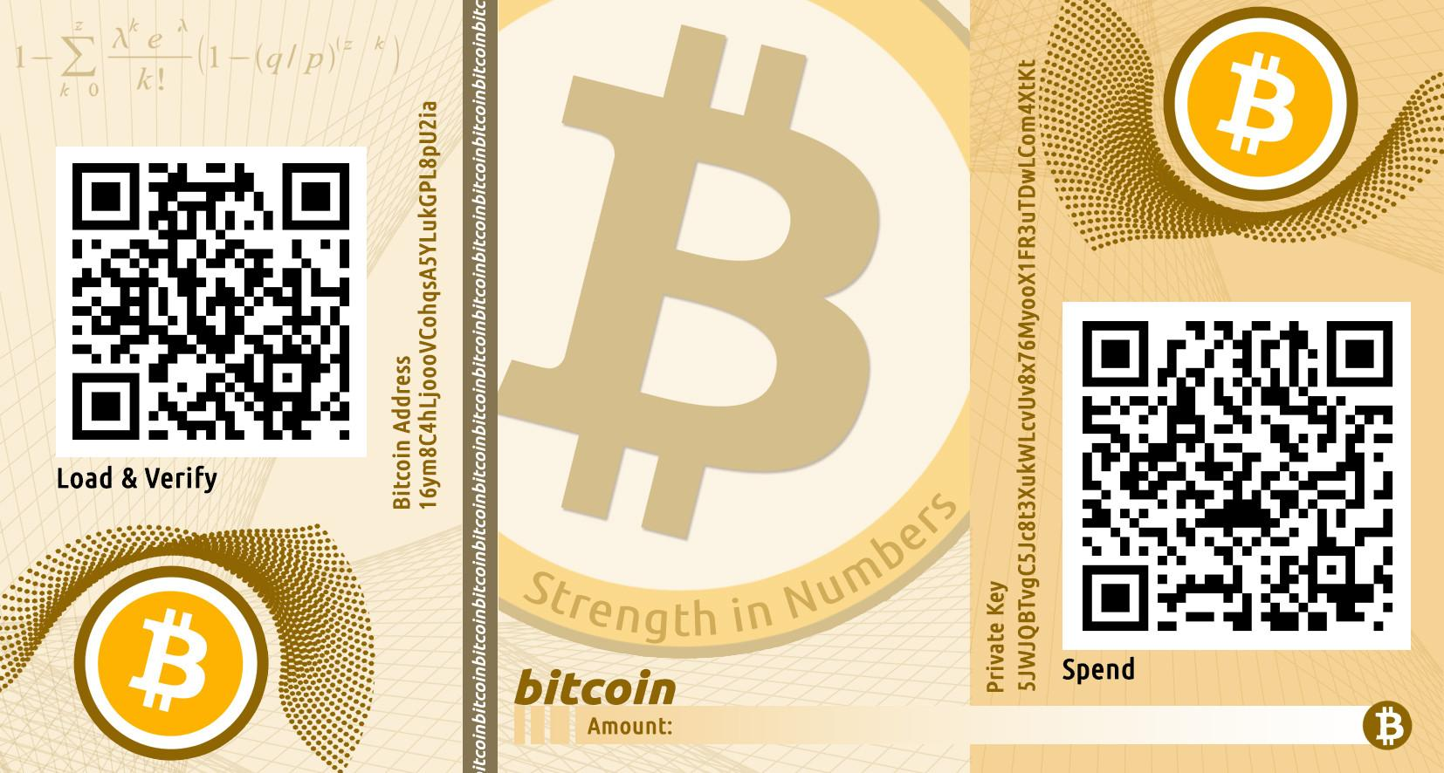
Paper wallet sample

Slide 6
Paper wallet creation
Generate private key on permanently air gapped device, eg old laptop with no wifi/ethernet, speakers, microphone or camera, don’t read your seed out loud.
Use dice?.
Print from a printer you control, assume printer stores all prints onboard. (Burn after using?)
Make duplicate copies, store at multiple locations.
Encrypt using BIP-38 - don’t forget your password ;)
Test you can decrypt before transferring funds.
Only spend once to reduce quantum attacks.

Slide 7
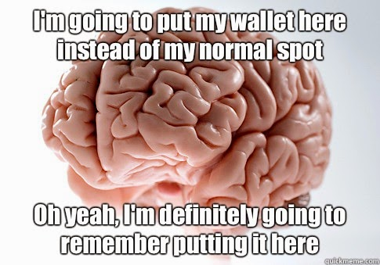
Brain wallet

Slide 8
Tips
Never sustain a brain injury, but plan for it.
Never create your seed your self.
Use a Mnemonic 12 word seed list.
Spend weeks performing a Mnemonic seed peg before transferring funds.
When you go through an airport and you’re asked “Are you carrying large amounts of cash on you?” don’t be a smart arse.
Print some HD public keys and send money to them over time, so as to be able to spend from your brain multiple times while remaining quantum resistant.

Slide 9
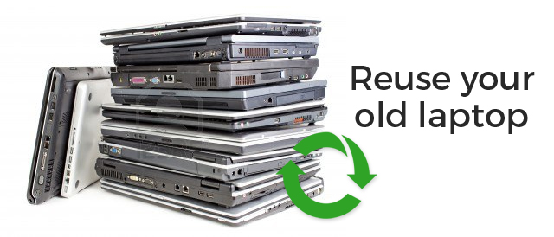
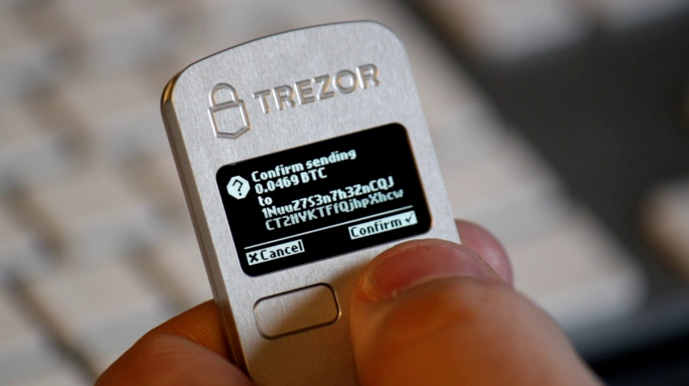
Hardware wallets
Hardware wallets can easily be created by technical users for free (using old parts laying around), however user friendly hardware wallets can be bought from as low as $30.

Slide 10
Great hardware wallets
Connect to any computer with an unlimited number of viruses.
Keys never leave the device, only signed transactions.
Use a 24 word Mnemonic seed, supporting your local language.
Are completely open hardware/software, unlike Yubikey etc.
Can connect to both PC and mobile.
Allow for an unlimited number of decoy wallets to prevent a $5 wrench attack.
Have an ever increasing password retry delay.
Support Additional features like 2FA - U2F
Must contain a screen to prevent PC malware.

Slide 11
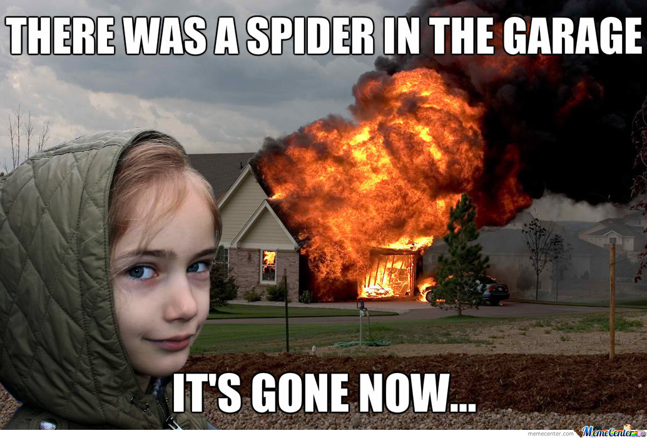
Paper and Hardware wallets….

Slide 12
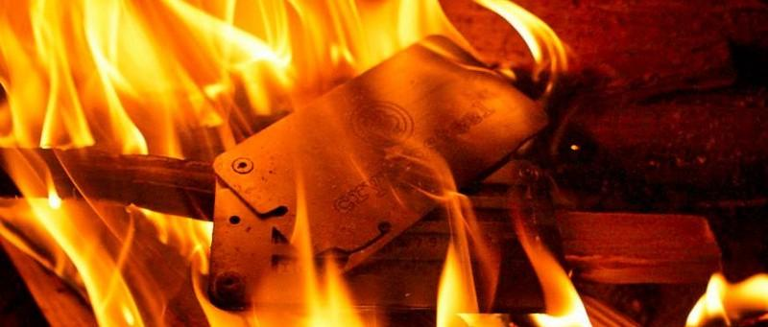
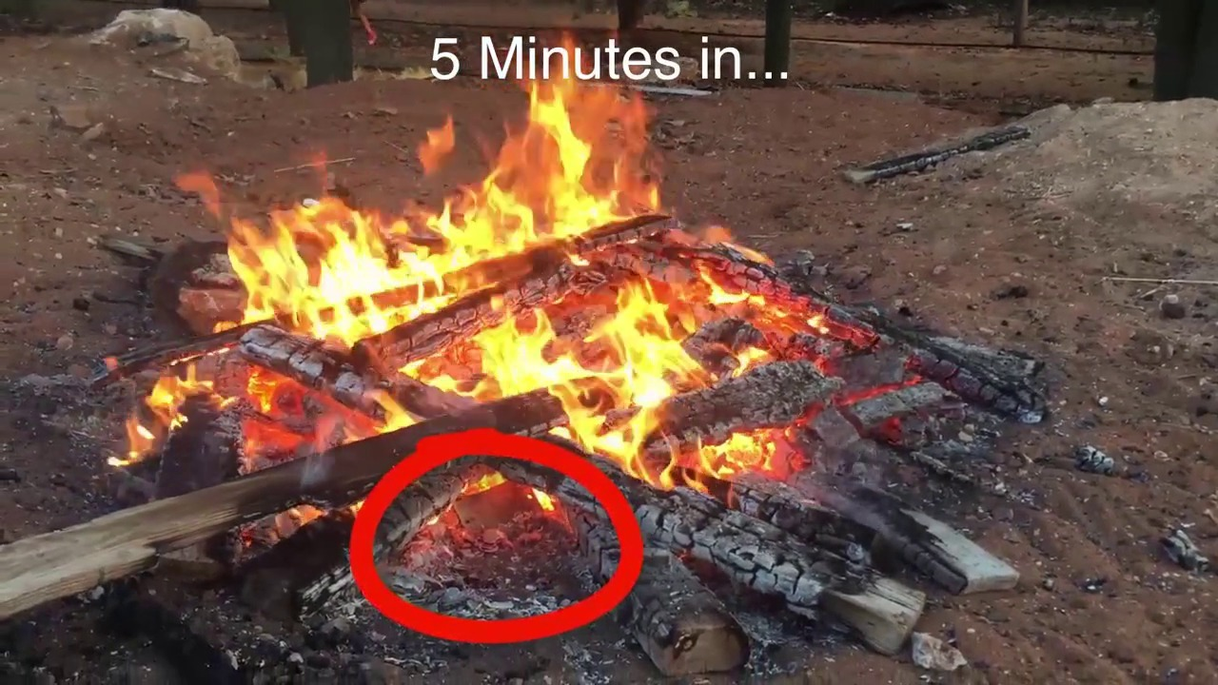
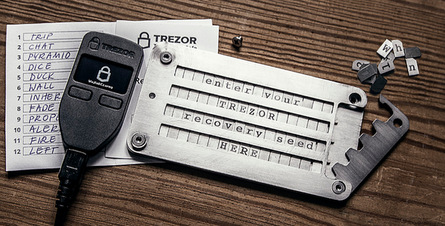
Cryptosteel

Slide 13
Cryptosteel
Will withstand fire up to 1200c.
Safe against solar flares.
Rust proof, 100% stainless steel.
Can store 24 words.
Open blueprints.

Slide 14
Final words.
Be paranoid.
Never store more than $100 on a phone.
If you plan to have over $200, buy a Ledge Nano S
If you plan to have over $500 buy a Trezor.
If you have over $1,000, buy a Trezor + Cryptosteel.
Be paranoid, never assume your computer is secure, never assume you know security better than others.
Further tips:
Have multiple decoy wallets on your trezor, have a Cryposteel concreted into the ground on 2 continents.
Be your own bank, don’t leave money on an exchange.
Don’t wait for permission, don’t ask for permission.

